Slide 1
Ph.D. Dissertation Proposal:
A Cognitive Computing Architecture
Scouting
A Way to Use Horsepower
To Navigate Through Huge Trees
In Real Time
John E. Lecky, University of Vermont
Department of Electrical and Computer Engineering
May 11, 1998

Slide 2
Overview
Part I: Computer Science
  Algorithms, thinking, and AI
Part II: Neurophysiology
  Architecture, anatomy, behavior
Part III: Cognitive Computing
  Scouting theory and results

Slide 3
“Building Machines That Think”
Existing computers out-compute humans (math, mostly) but don’t out-think us
The goal of “thinking machines”
  sidetracked by the fact that we don’t know how thinking works
What’s the difference between computing and thinking?

Slide 4
Computing: Algorithms
Sedgewick’s definition: a problem-solving method “suitable for implementation as computer programs”
The missing piece: On what computer?
Thousands of known “problems without algorithms” (NP-complete)

Slide 5
Thinking
Definition: the generation of new information from old
One key property: spontaneous generalization (making inferences about general information you didn’t know in the first place)
This property is non-deterministic, which rules out any algorithm

Slide 6
Thinking about Algorithms: Conclusions
Thinking by definition cannot be algorithmic
In fact, we can redefine thinking as: solving problems without using algorithms
Trial-and-error (fast, please) is the only path to spontaneous generalization that I can “think of,” and leads to...

Slide 7
Other Non-algorithmic Properties
Inspiration, creativity, brilliance
All characterized by our own admission of a chance element
  I had a flash of inspiration
  Suddenly, it came to me
  I was walking the dog, and WHAM!
  Eureka!
Thinking is very different from computing

Slide 8
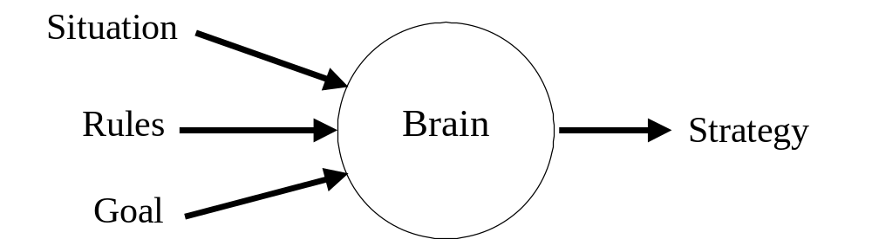
Situation, Rules, Goal
Thinking is some ensemble property of the brain
We can study some puzzles to think about how humans do this

Slide 9

Example Puzzle:
8-puzzle

Slide 10
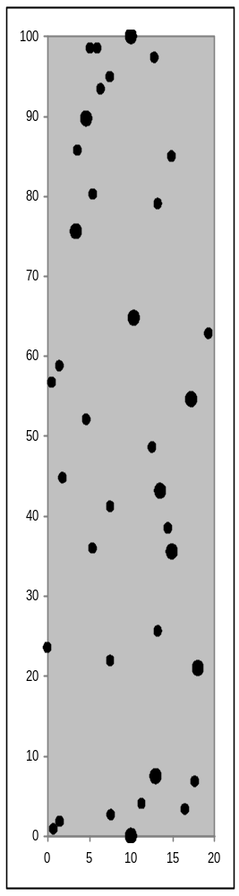
Example Puzzle: Stream Crossing

Slide 11
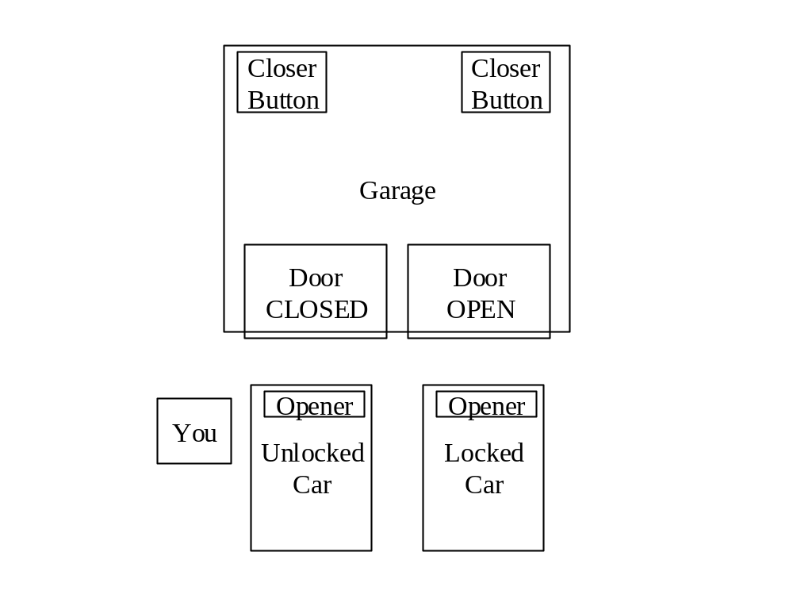
Example Puzzle
Garage Door

Slide 12
So How Do Animals Think?
A Fly
  1 million neurons
A chimpanzee
  25 billion neurons
A human
  100 billion neurons
  the first 20 billion must be uninteresting

Slide 13
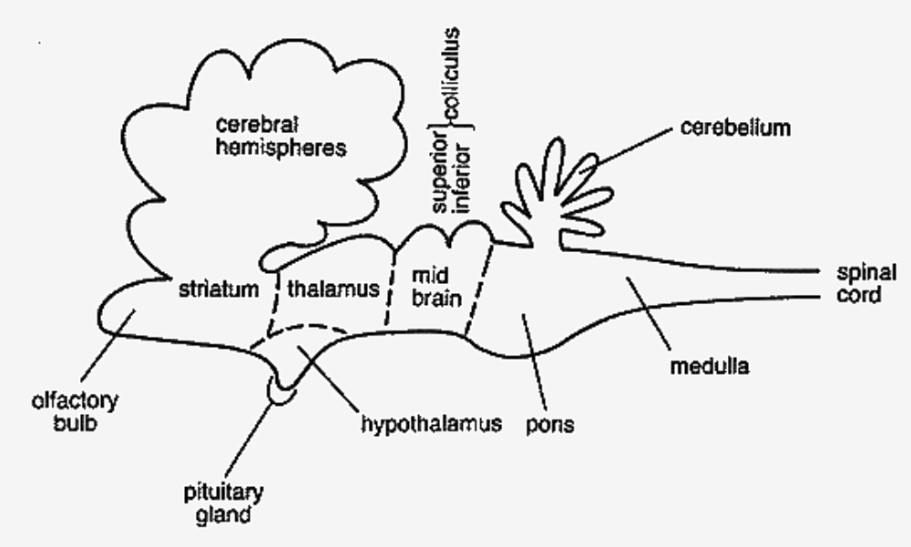
Brain Architecture
Direction of evolution

Slide 14
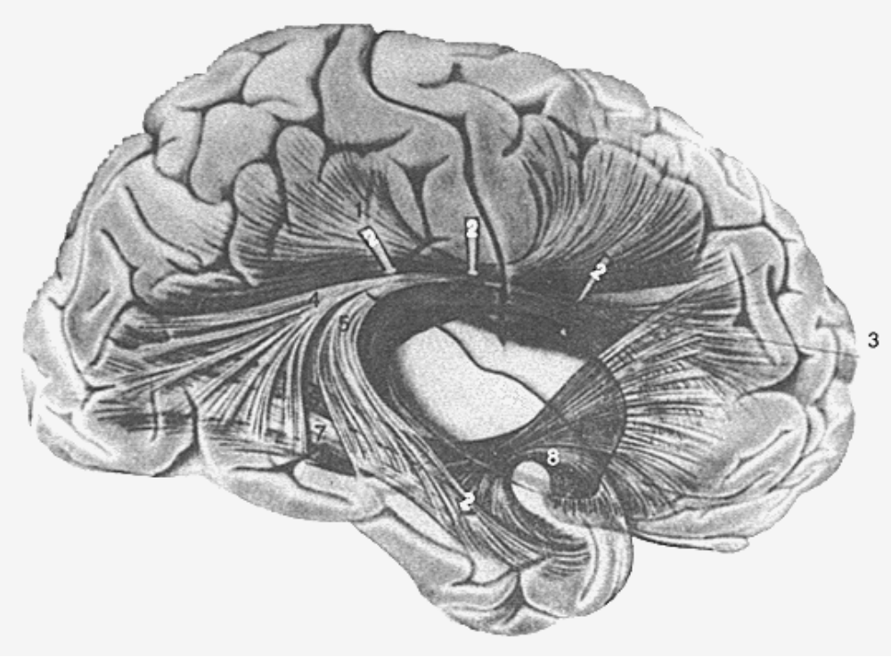
The Neocortex
Why is it so BIG in humans?

Slide 15
Neural Macrocolumns
Controversial organization of the neocortex, but evidence is compelling
Architecture is cylindrical “modules” of 100-2000 neurons, 0.5 mm in diameter, extending through all 6 cortical layers
These modules are VERY LOOSELY homogeneous; humans have ~1,000,000

Slide 16
What Might These Modules Do?
Note: PRIOR to initiation of motion, great activity is observed in the motor cortex
This is believed to be planning
This (or any) planning could be many simultaneous simulations of the motion, waiting for one simulation to “succeed”

Slide 17
Digital Macrocolumn: Scout
A “scout” processor makes random forward moves until it hits the goal or is reset
It has limited ability to avoid backtracking
Advantages
  no coordination overhead
  simple design can be built in HARDWARE

Slide 18
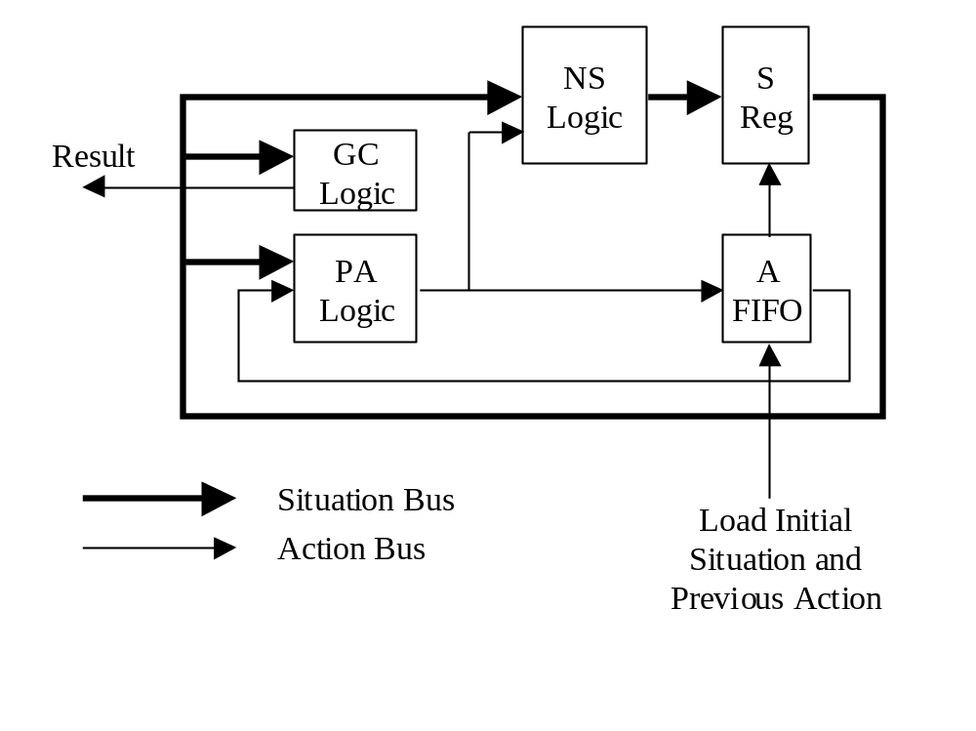
Scout Block Diagram

Slide 19
Scouting Pros and Cons
Pros
  NO ALGORITHM REQUIRED; just SRG
  eliminates problem of coordination and record keeping
Cons
  many scouts can follow the same route, doing no additional productive work

Slide 20
The Economics of Scouting
Large n with simple processor, or small n with complex processor?
Scout size in gates and memory is 2 or more orders of magnitude smaller
Also, scout execution speed is 2 or more orders of magnitude faster
Economics are quite compelling

Slide 21
Another Scouting Benefit
A complete scout for a simple problem like the 8-puzzle can easily be fit onto a fraction of a CPLD
Building networks of 1000s of scouts is feasible NOW at a cost of <<$100/scout
Field-programmable CPLDs...

Slide 22
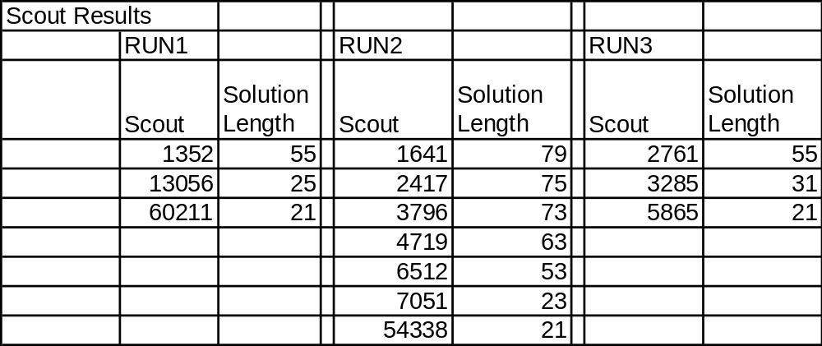
8-puzzle Simulation Results

Slide 23
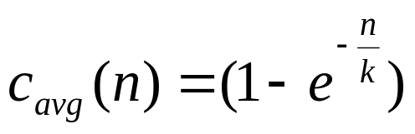
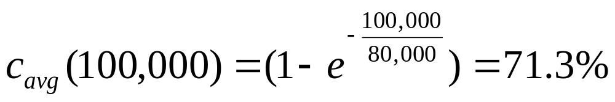
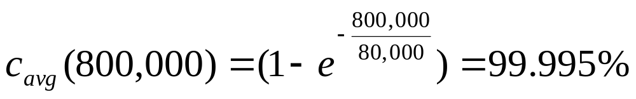
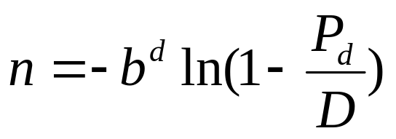
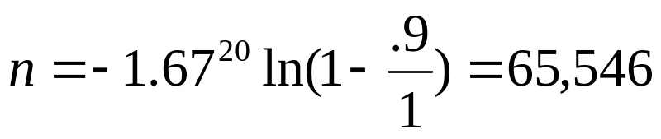
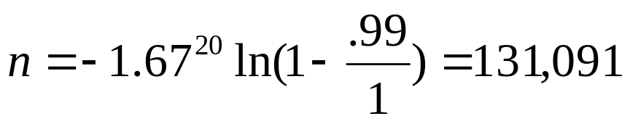
Scouting Theory and Examples

Slide 24
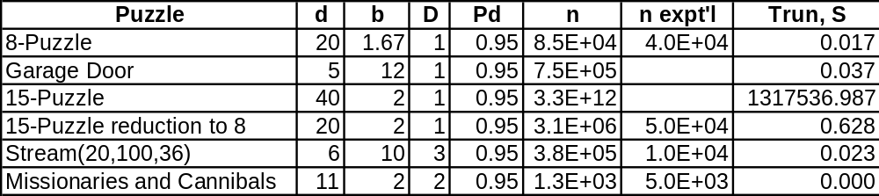
Runtime Estimation
Assume move generation at 100 MHz
15-Puzzle: the notion of Stepped Goals

Slide 25

Stepped Goals
Not unlike human problem solving compartmentalization
Problems that are “too hard” are only “too hard” relative to some desired n

Slide 26
Tasks Completed
Computer Science, Neurophysiology, and Cognitive Psychology selected overview
Simulation completed, tested on:
  8/15 puzzle
  stream crossing, garage door, n-queens, missionaries/cannibals, knights crossing, simple games
theoretical justification completed

Slide 27
Additional Work for the Dissertation
More complete reporting of additional results (no new conclusions)
Experimental verification of fundamental relations
Additional relationships for comparing “cost” wrt traditional computing techniques; comparison with A* for 8-puzzle

Slide 28
Future Projects
“Fabrication” (VHDL) of actual devices
Real-time applications
  network routing, VLSI test generation, speech recognition, general optimization and scheduling, etc (NP is a large area!)
Ideas for using scouting to optimize data storage and recognition

Slide 29
Questions

